Slide 1
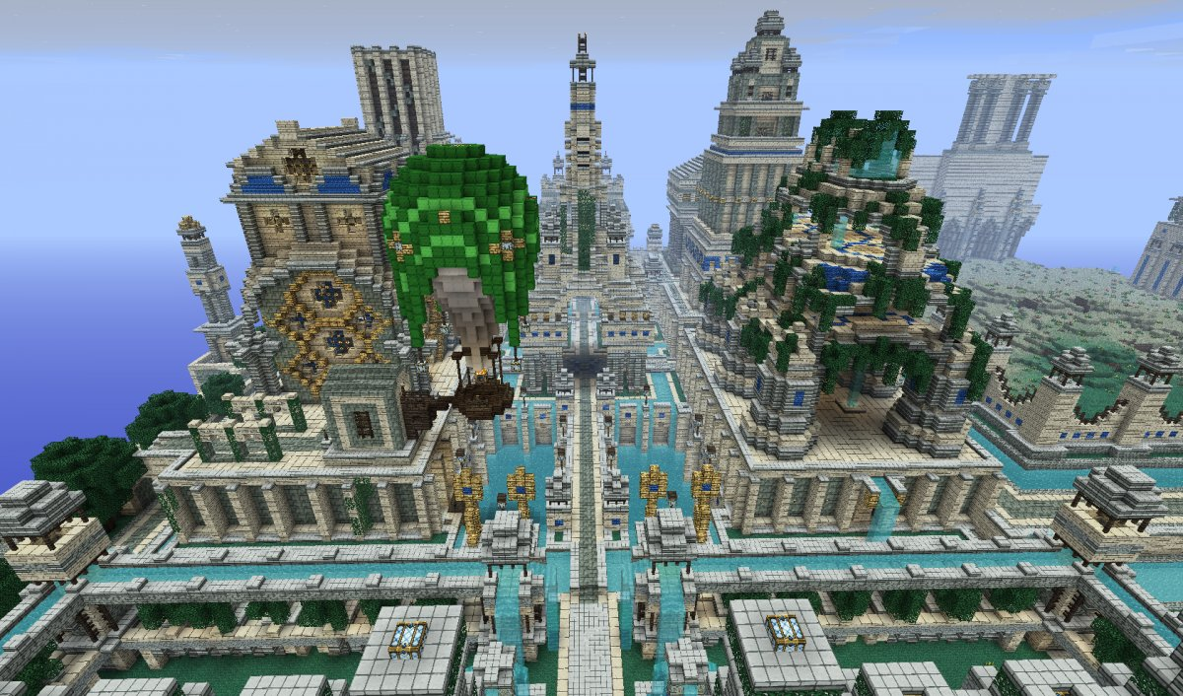
Psychology and Motivation 2:
Mechanics and Play

Slide 2


Some typical responses:
“fun”
“role-play/simulation”
“hang out with friends”
“compete with others”
“enjoy a good story”
“create”

Slide 3


Mihaly Csikszentmihalyi

Slide 4
“Flow” and its components
Theory often used to describe the joy people find in playing video games.
“A state of concentration and satisfaction that a person experiences when performing an activity—whatever it is--so much that it becomes an optimal experience.” (167)
Can be achieved through completely different activities.
Challenging: goal-oriented, with rules, and presenting feedback.
Complete immersion: total mental absorption, forget about time and reality, loss of self-consciousness.
Paradox of control: exercising control where your abilities are pressed to the limit.

Slide 5
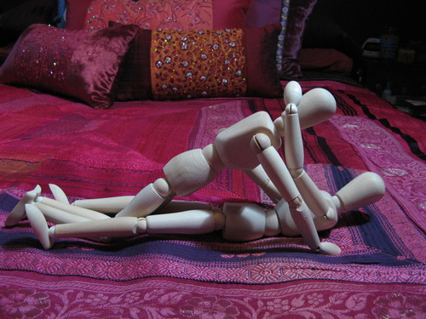

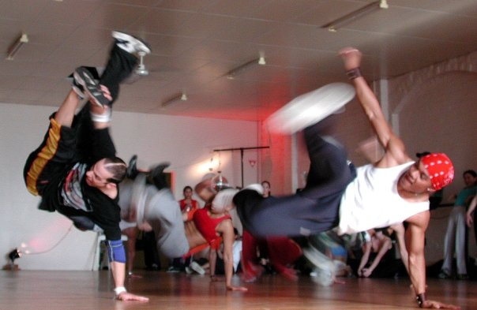

FLOW

Slide 6
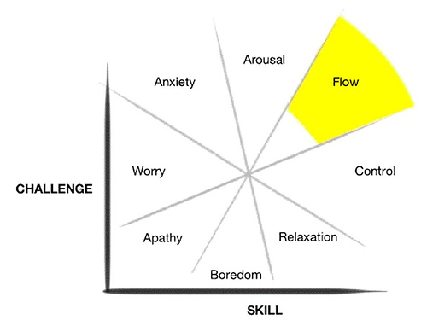
The key to attaining “flow” is balance.
The problem: Flow is too general a theory. Why do people specifically play video games?

Slide 7


Jane McGonigal
Games provide what reality cannot:
Satisfying work
The hope of being successful
Social connection
Meaning—being part of something larger than ourselves.

Slide 8

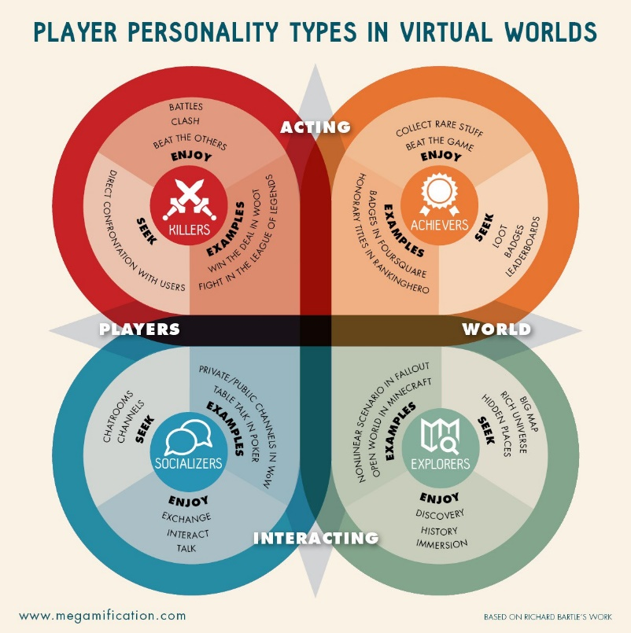
Bartle’s Taxonomy of Player Types
A classification of video game players by Richard Bartle (ie: game designer, MMO pioneer, smug guy to the right).
Classified players into four types: Killers, Achievers, Socializers and Explorers.
The beginning of ‘gamer psychology’ and motivation
Both praised as a sound framework and a limiting one: applies mostly to MMOs but is ‘pushed’ (unsuccessfully) onto other genres.
Take the test yourself to see where you fall: I’m 60% explorer, BTW.

Slide 9
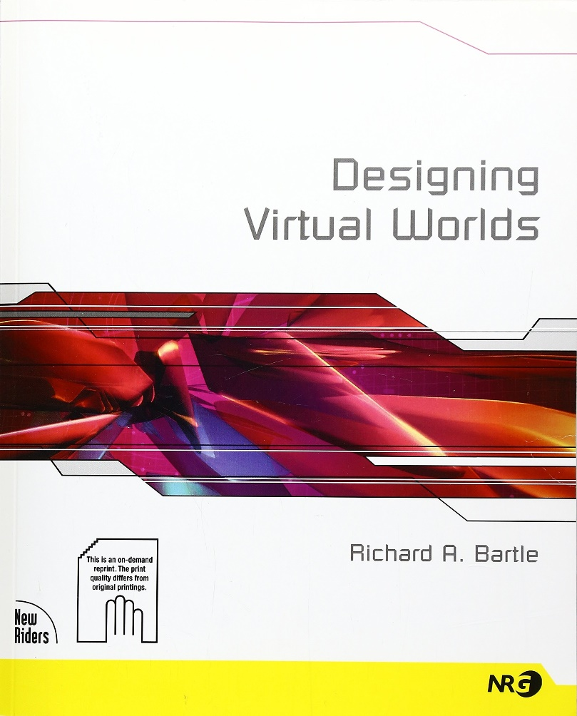
Philosophical Questions About Design and Motivation
Playing games fills a “need”—the real question is (as designers) what are the needs of your players?
Do you design a game for all players or one player type?
Is there a right and wrong (or ethical/unethical) way to design the game?
Should you cater to all your players’ “wants”—even if they have negative consequences?
At what point is your game design exploiting your players’ wants as opposed to merely satisfying them?

Slide 10

Extrinsic and Intrinsic Motivation: Brief Definitions
Extrinsic Motivation: The individual is motivated by EXTERNAL forces—praise, money, fame, items.
EXAMPLE: Many people go to their jobs not because they love them, but because of the paycheck. If they weren’t paid, they would not go.
Intrinsic Motivation: The individual is motivated by INTERNAL forces—curiosity, creativity, a desire to learn
EXAMPLE: You take guitar lessons because you want to—not because you’re paid to or you have to. You are internally motivated.
THE PROBLEM: Motivations can be manipulated and rearranged. People can be ‘tricked’ and ‘trained’ into potentially negative behaviours.

Slide 11
Muhlbock’s Taxonomy of Game Types and Player Motivation
Like in any classification system, overlapping exists; however, here are five categories of games as they appeal to specific player ‘wants’ or types:
The Game as Sport: competition
The Game as Story: curiosity
The Game as Project: creativity
The Game as Simulation: contact and connection
The Game as Goods: consumerism and collecting

Slide 12
The Game As SPORT
Appeals to Bartle’s ‘killers’ and ‘achievers’
Player motivation is competition, both with one’s self and/or others: a focus on the destination as opposed to the journey.
Intrinsic Motivators: Goal completion or Endurance
Extrinsic Motivators: Fame, Fear or Glory
Designer Exploitation: pay to win, pay for cosmetics, leaderboards, any type of numerical/material ranking.
Overlaps well with ‘game as goods’ and ‘game as project’

Slide 13

The Game As SPORT: Examples
Consider “survival” games like PUBG, Fortnite, DAY Z, Rust, or Ark: Survival Evolved
Consider solo or team based combat, be it in MOBA’s, Sports Games, RTS’s or MMOs.
Consider mechanics like leaderboards, achievements, difficulty levels, or even ‘points.’

Slide 14
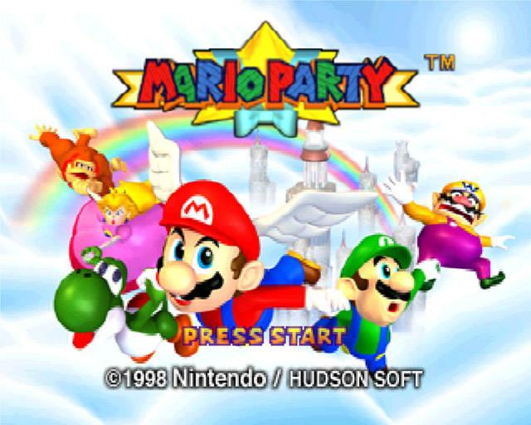
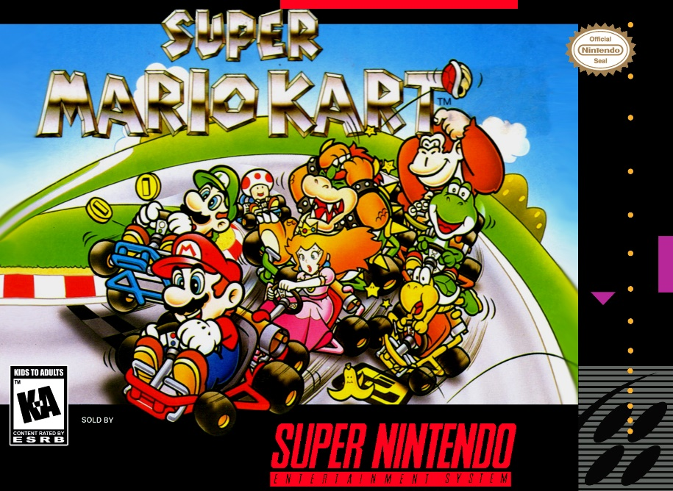
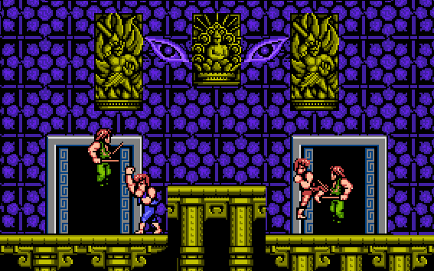
The Good: Co-operation and Competition
Humans are social animals: we desire companionship—instinctually
Working together for common goals is rewarding simply for allowing us to engage and interact with one another.

Slide 15
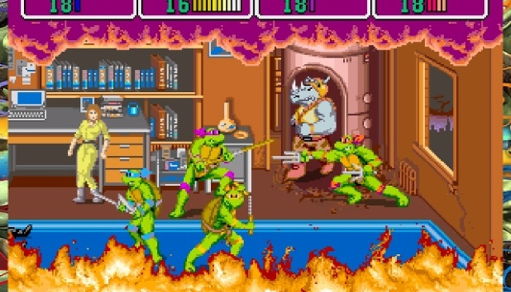
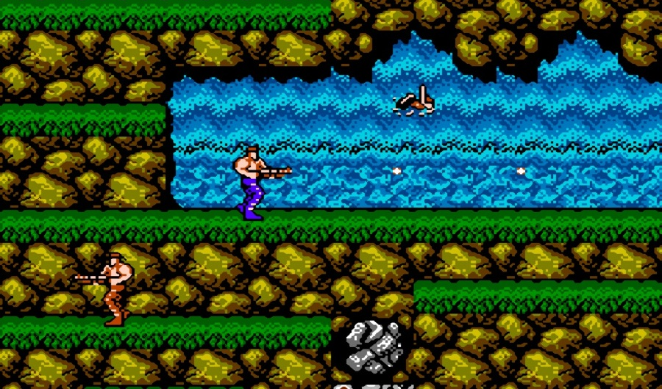
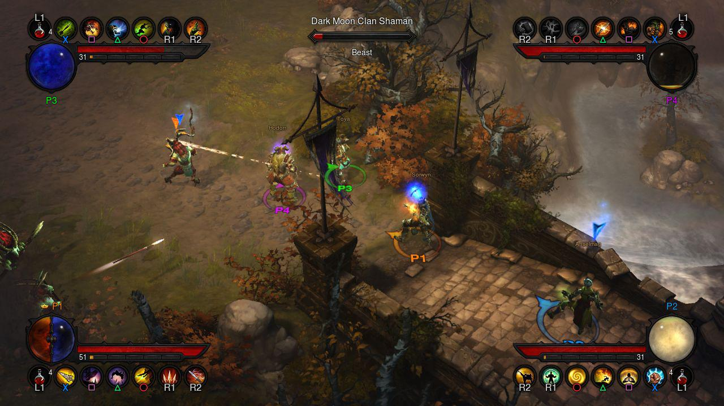
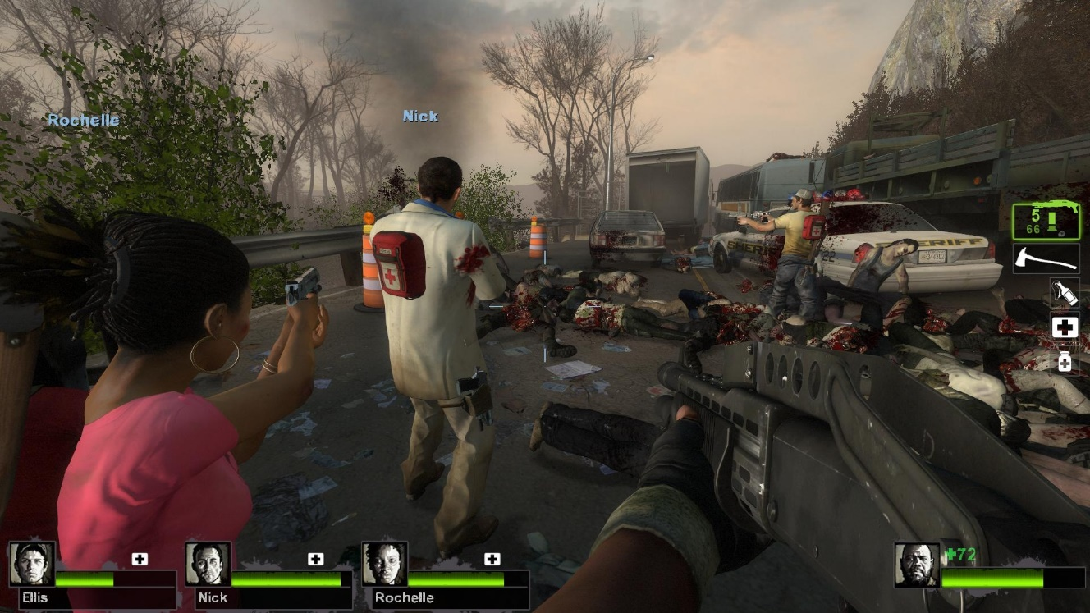
The Co-operation part…

Slide 16
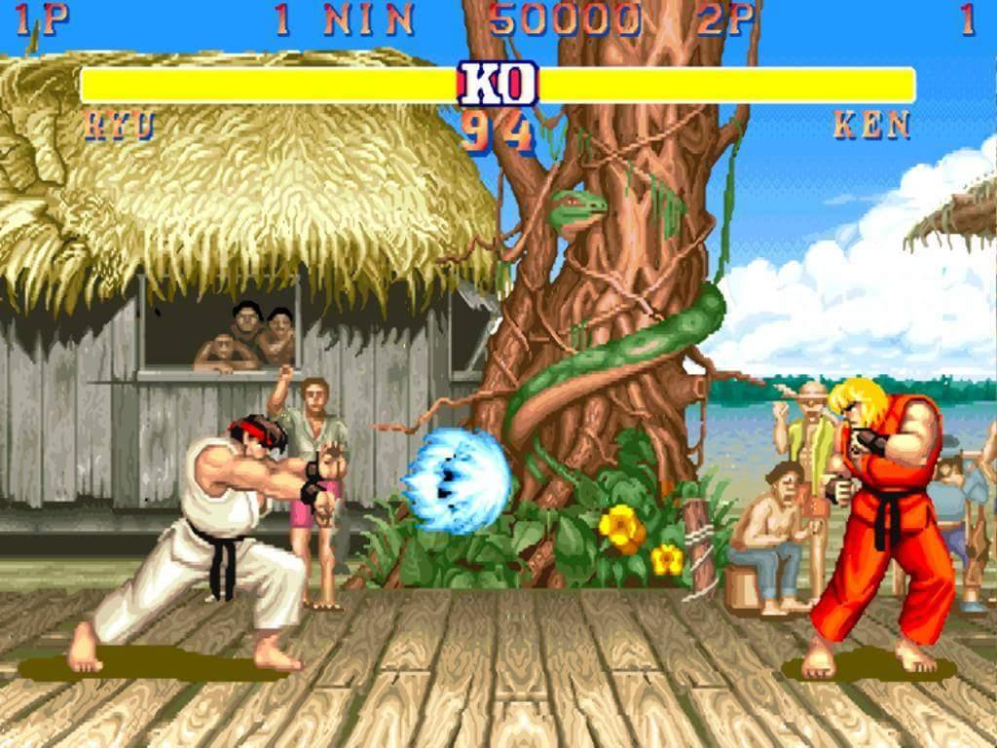
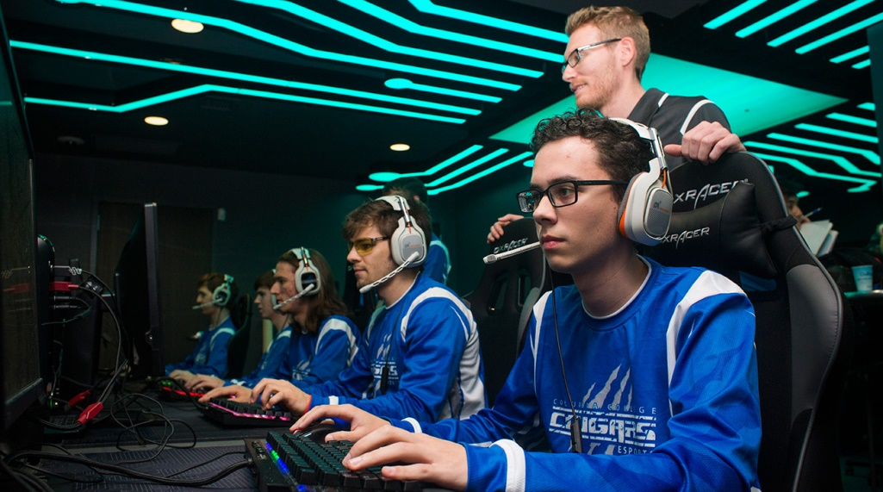
From Intrinsic to Extrinsic : Competition to Extremes
And yet, very soon, friendly competition and the intrinsic desire for a sense of accomplishment can become an all consuming ‘addiction.’
An extrinsic desire for recognition or fame—‘chasing the dragon’—with no end in sight.
The compulsion to become #1 for some people is fierce: the problem is that no one can be #1 forever…so where does it end?
Put simply: Are you gaming for yourself or gaming for others?

Slide 17
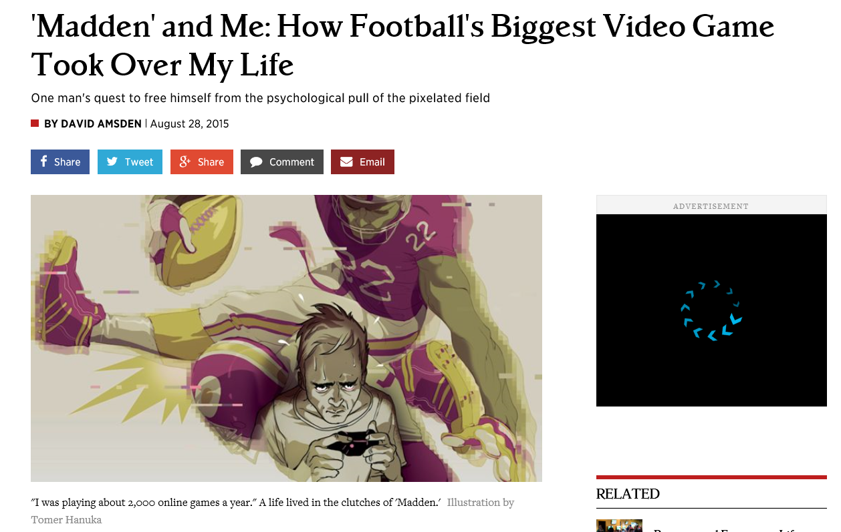
'Madden' and Me: How Football's Biggest Video Game Took Over My Life | Rolling Stone

Slide 18
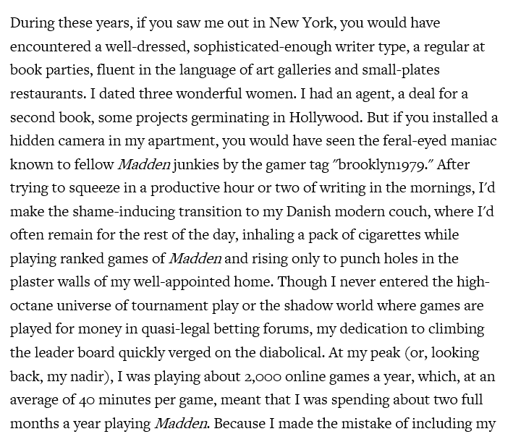
“Madden, a monstrously popular video game that has sold more than 100 million copies in its 27-year history, features a "leader board" on which the game's nearly 2 million online players can see where they rank in comparison to the competition. A devilish feature, this. For a thirtysomething adult with a Type A personality and some unaddressed life issues — i.e., me — it transforms Madden from an escapist pastime into another stage on which to prove your self-worth. By the release of Madden '10, in 2009, I was consistently ranked in the top 100 players online, and by Madden '13, I was a regular presence in the top 10.”

Slide 19


Player Unknown’s Battlegrounds (2017)
2017’s most successful game
Developed by Brendan Greene originally as a mod for ARMA and H1Z1—but was then turned into a standalone game. Basically created a new genre: Battle Royale
Gameplay: 100 players drop into a large map with nothing. They must find, create, and kill. Scrounge and survive with only 1 player winning. Die and you’re out.
A perfect combination of the ‘game as sport’ and ‘game as project’ with a little bit of ‘game as story’ thrown in!

Slide 20


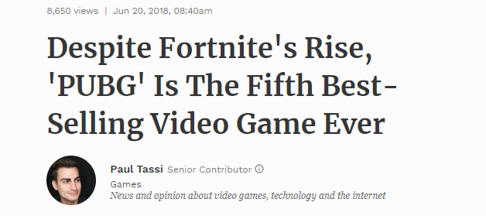
Fortnite: Battle Royal (2017)
Riot Game’s answer to the Battle Royal genre. More “cartoony” than PUBG in art style and weapons/abilities (meaning parents will let their children play).
A free to play game, which also certainly added to its popularity.
A cultural phenomenon with streamer Ninja as the game’s celebrity ambassador.

Slide 21
Meaningful Challenge in Game Design
People are more motivated when they pursue goals that have personal meaning, that relate to their self-esteem, when performance feedback is available, and when attaining the goal is possible but not necessarily certain.
Regarding games:
Games give instant feedback
Game offer several levels of difficulty
Consider levels of difficulty in your favorite games as well as evolutions (and innovations) in game design regarding challenge and difficulty.

Slide 22
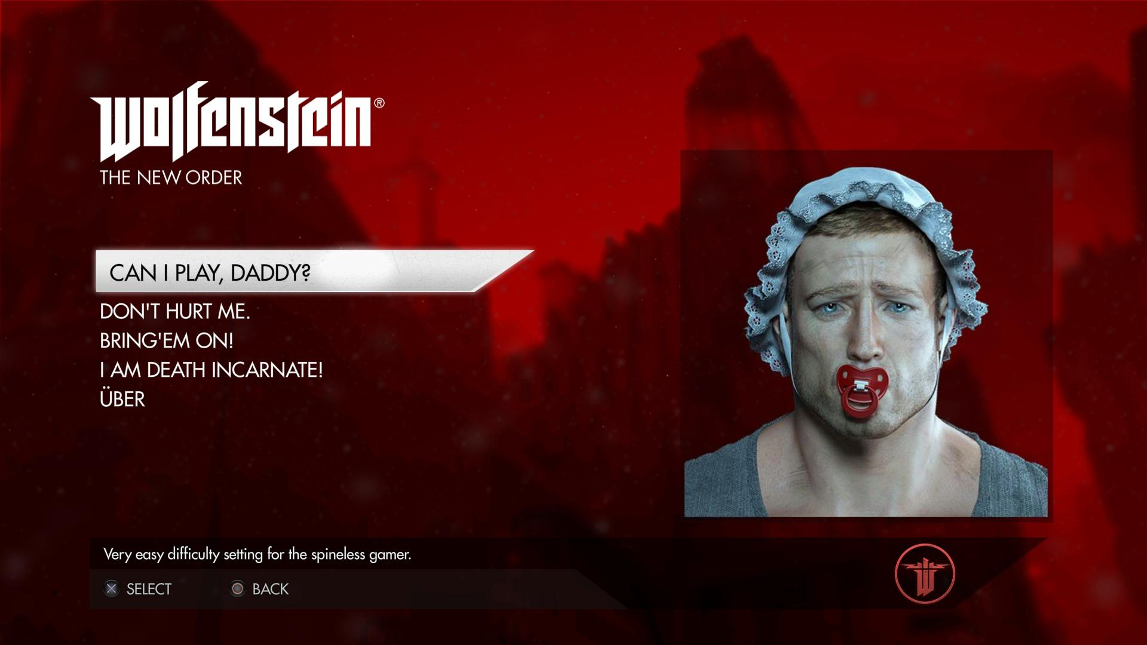

Slide 23
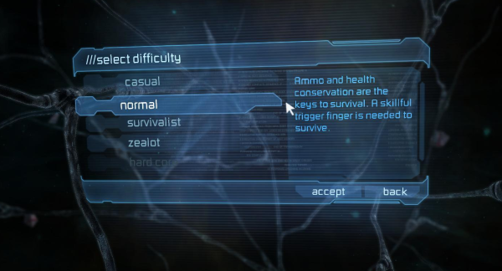
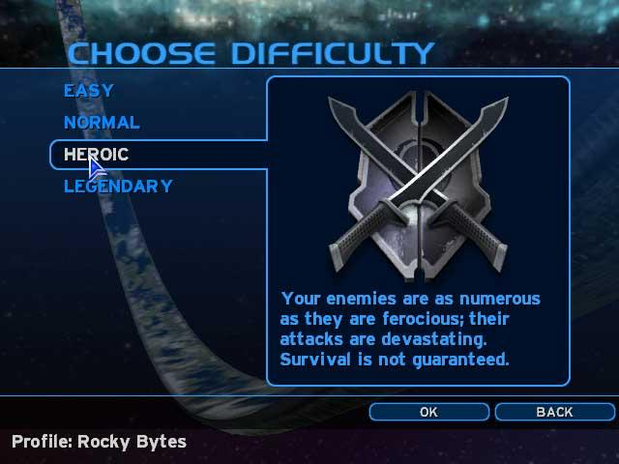
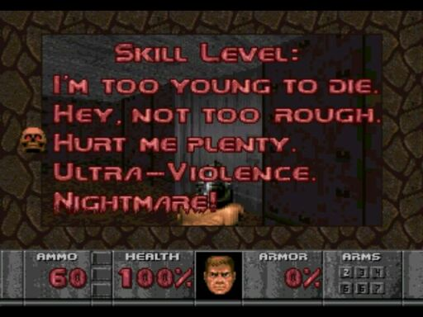
Challenge goes hand in hand with the ‘game as sport’ mentality, whether it is ‘PvP or PvE’—a psychology that craves ‘human vs human’ or ‘human vs machine’ dominance. The dilemma, again, is how far should designers go to implementing mechanics that satisfy these motivations? What is meaningful, satisfying challenge and what is simply cruel and exploitive?

Slide 24
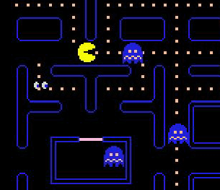
Designing Challenge in Games
Often simply “endurance tests”—games of attrition
More enemies
Enemies do more damage
Less lives
Lower health
Less frequent power ups
Send player back to beginning of level or GAME
Punishing trail and error
No grace periods for damage or experimentation
Time limits
(randomly) respawning enemies
Bigger, badder bosses.

Slide 25
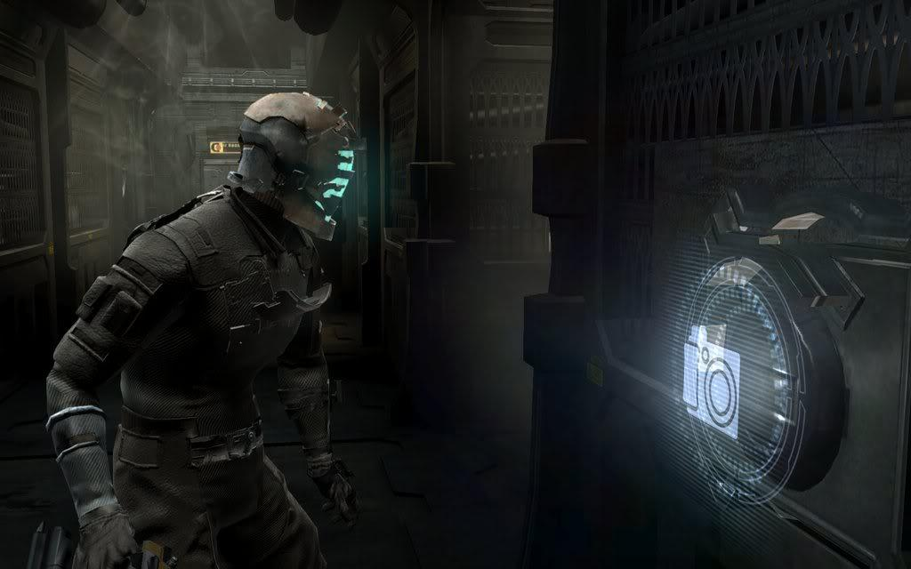
Save Points & Checkpoints Vs. Save Anytime?

Slide 26
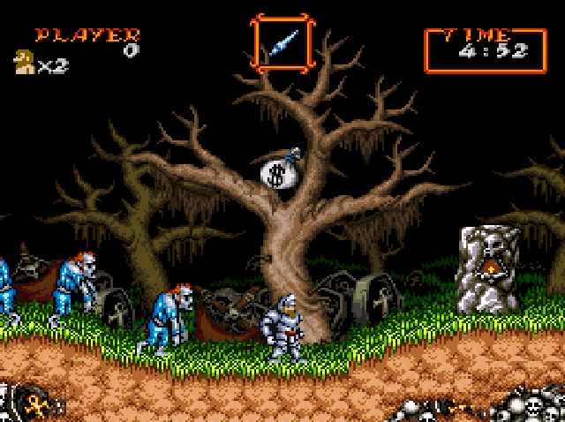

Super Ghouls and Ghosts (or Ghosts and Goblins): notorious for its “two-hit” damage meter and for making players play through the entire game TWICE to complete it.

Slide 27
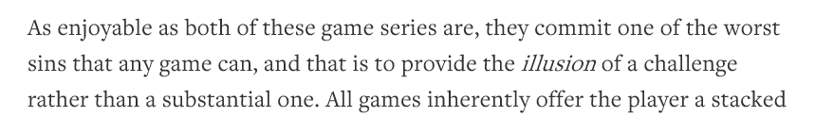
“Uninspired” Challenge in Game Design
Relative Difficulty: The Line Between Challenging and Frustrating | The Artifice
Call of Duty 2: “the only difference between the Recruit and Veteran settings is the amount of times you can get shot before you die. Aside from that, the levels, weapon layouts, and game mechanics remain the same.”
“The same goes for the Halo franchise. Playing on the Legendary setting isn’t a true test of your wits, it’s just a sophomoric endurance test that wants to see how long you’ll play before you chuck your controller out the window.”

Slide 28
Regarding Halo
“The skull system is more or less an Easter-egg hunt that requires the gamer to find hidden skulls throughout the campaign that unlock a variety of challenges upon repeat play-throughs. For example, the Fog skull disables the Motion Tracker on your Heads Up Display (HUD), so you won’t be able to see where your enemies are coming from, while the Famine skull makes ammo much more scarce, so you have to choose your targets carefully and be precise when you go for them. These are challenges that affect your reaction time, your aural and visual senses, and your management skills; in other words, they are actual challenges. But for some reason, Bungie thought that they’d be much more fun as bonus material that has to be unlocked rather than an integral part of the campaign.”

Slide 29
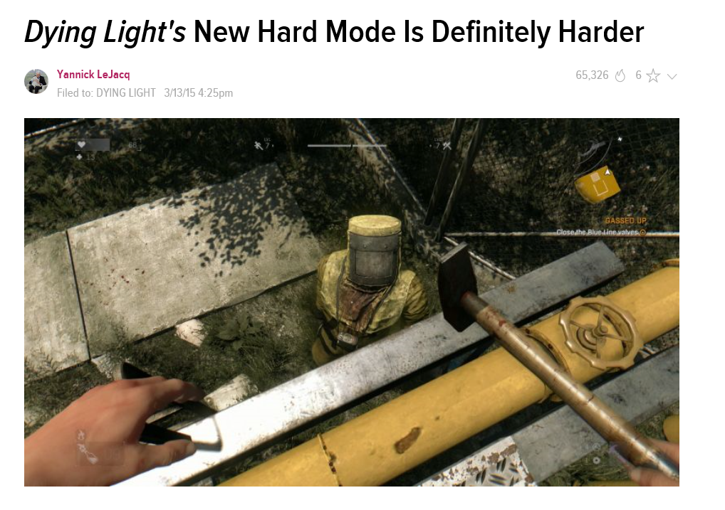
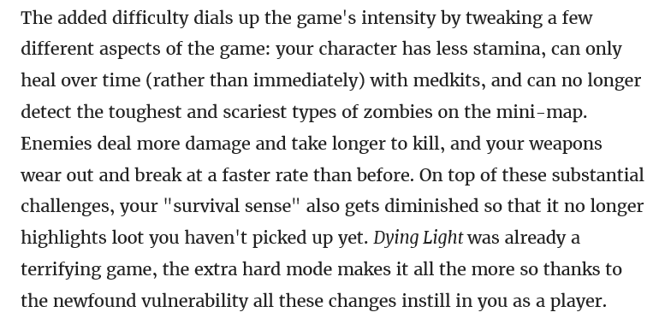
Challenge in Game Design

Slide 30
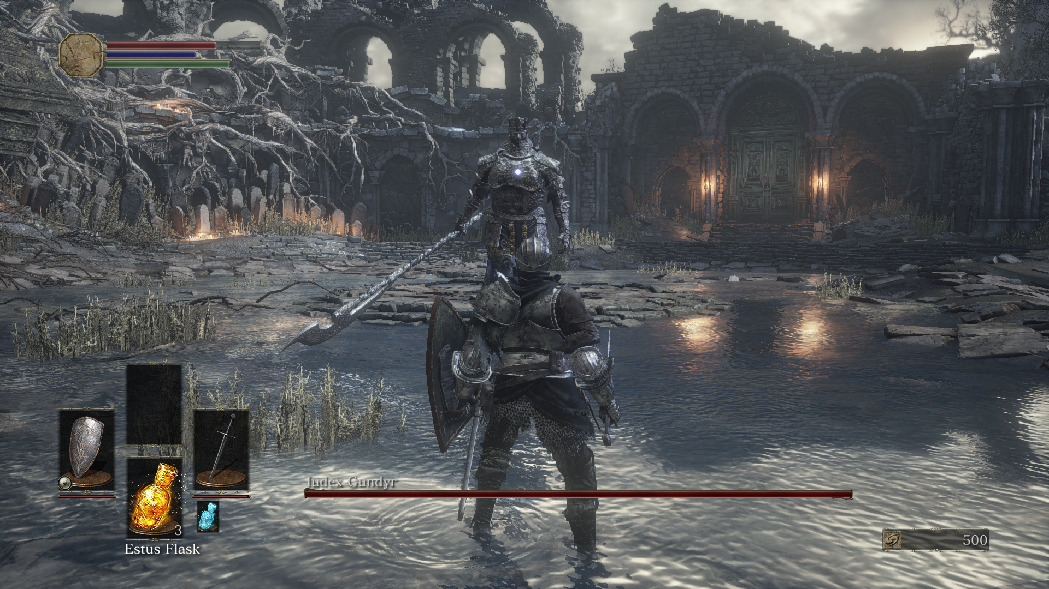
No discussion about “challenge” would be complete without talking about Dark Souls. The game is punishing and unforgiving, but it’s never unfair. In fact, the gameplay’s mechanics encourage a fair amount of strategy given that the game is a “hack and slash” at heart.
Errant Signal - Dark Souls 3 (Non-Story Spoilers?) - YouTube

Slide 31
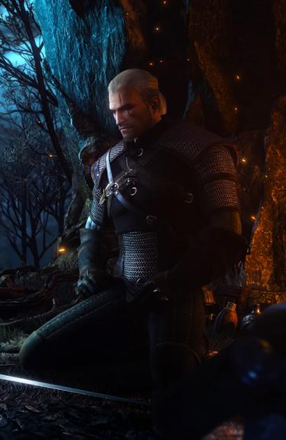
Regenerating Shield/Health
Modern games’ replacement of the lives system.
Regenerating Shield popularized by Halo
Regenerating Health popularized by COD.
Used in countless games since.
Replaces the need to find health packs
A good or bad innovation regarding challenge? Depends on the game…
Witcher 3: no regenerating health, but heal with “meditation?”

Slide 32
The Game As STORY
Appeals to Bartle’s ‘explorers’ and ‘achievers’
Player motivation is curiosity—a focus on the journey as well as the destination.
Intrinsic Motivators: a need to know, a need to discover
Extrinsic Motivators: trendiness, partake in conversation
Designer Exploitation: multiple endings, branch-excluding morality systems, useless map content or uninspired ‘fed ex’ side quests.
Overlaps well with ‘game as simulation.’

Slide 33
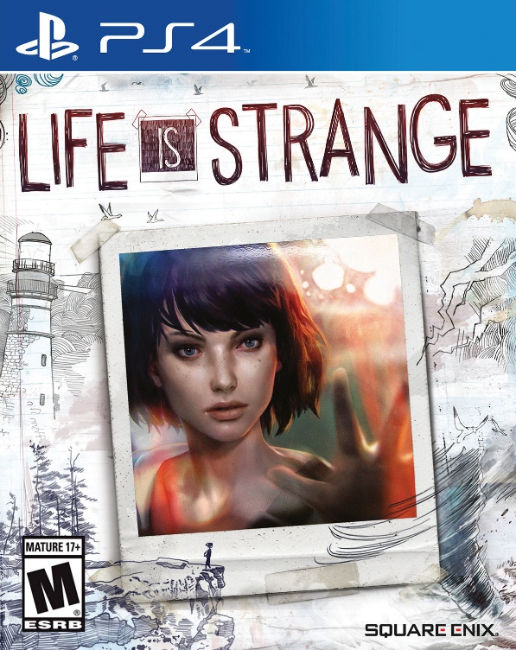
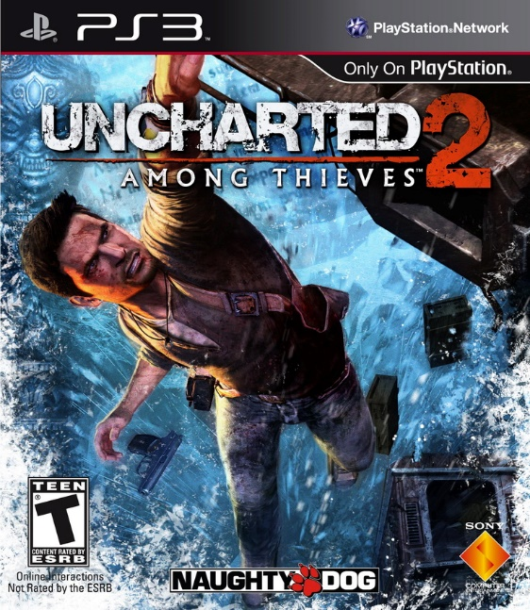

The Game As STORY: Examples
Consider strong single player narratives.
Consider emergent games where players create their own stories or piece together lore
Consider mechanics like morality choices, side quests, environmental narrative, and (the potentially exploitive) multiple endings.

Slide 34
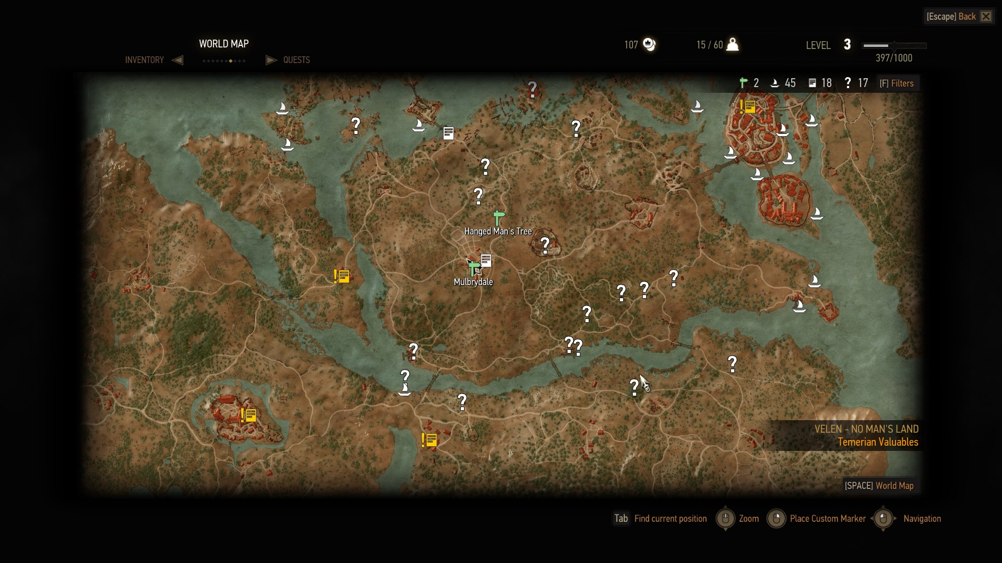
Unexplored areas of the map…

Slide 35
The Game As PROJECT
Appeals to Bartle’s ‘explorers’ and ‘socializers’
Player motivation is to create—a focus on making the journey and setting the destination.
Intrinsic Motivators: discovery—what can I do? What can be done?
Extrinsic Motivators: Fame, Recognition
Designer Exploitation: too much content or too many options, perhaps (?)
Overlaps well with ‘game as story.’

Slide 36

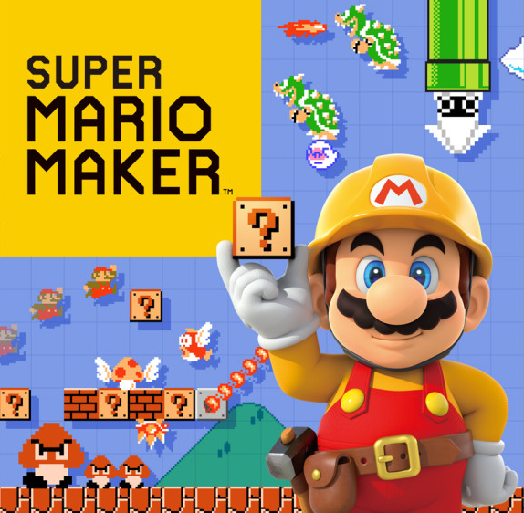
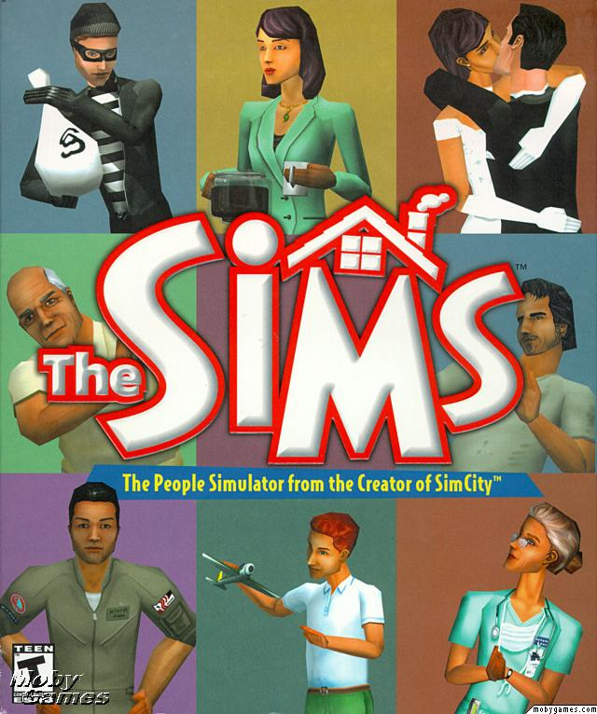
The Game As PROJECT: Examples
Consider emergent aspects of game design--PLAY.
Consider games that are more like ‘toys’ for players than games.
Consider features like crafting systems or player customization in its many forms.
Consider game mods and the entire modding community.

Slide 37







In fact, consider WEB 2.0
Consider how the most popular sites on the internet all have to do with creating and sharing (and collaboration).

Slide 38


Minecraft (again!)
Developed by Markus “notch” Persson.
Original (early) version of the game was only “creative mode”—no monsters, animals, or characters: and it was still WILDLY popular.
During one 24 hour period the game sold 23,000 copies—one game every 3 seconds.
The innate (instinctual) desire to CREATE and SHARE and the intrinsic motivations that come with this action largely explain the game’s phenomenal success.
“Minecraft” googled more often than Harry Potter, Justin Bieber, The Bible. 60 million copies sold.
Has made over $700 million and counting…

Slide 39
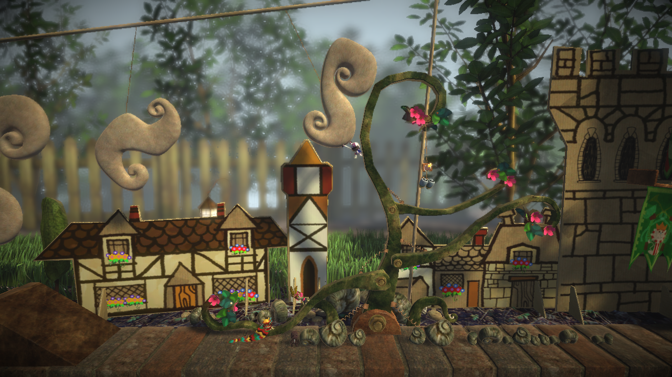

Little Big Planet: “Play, Create, Share”

Slide 40
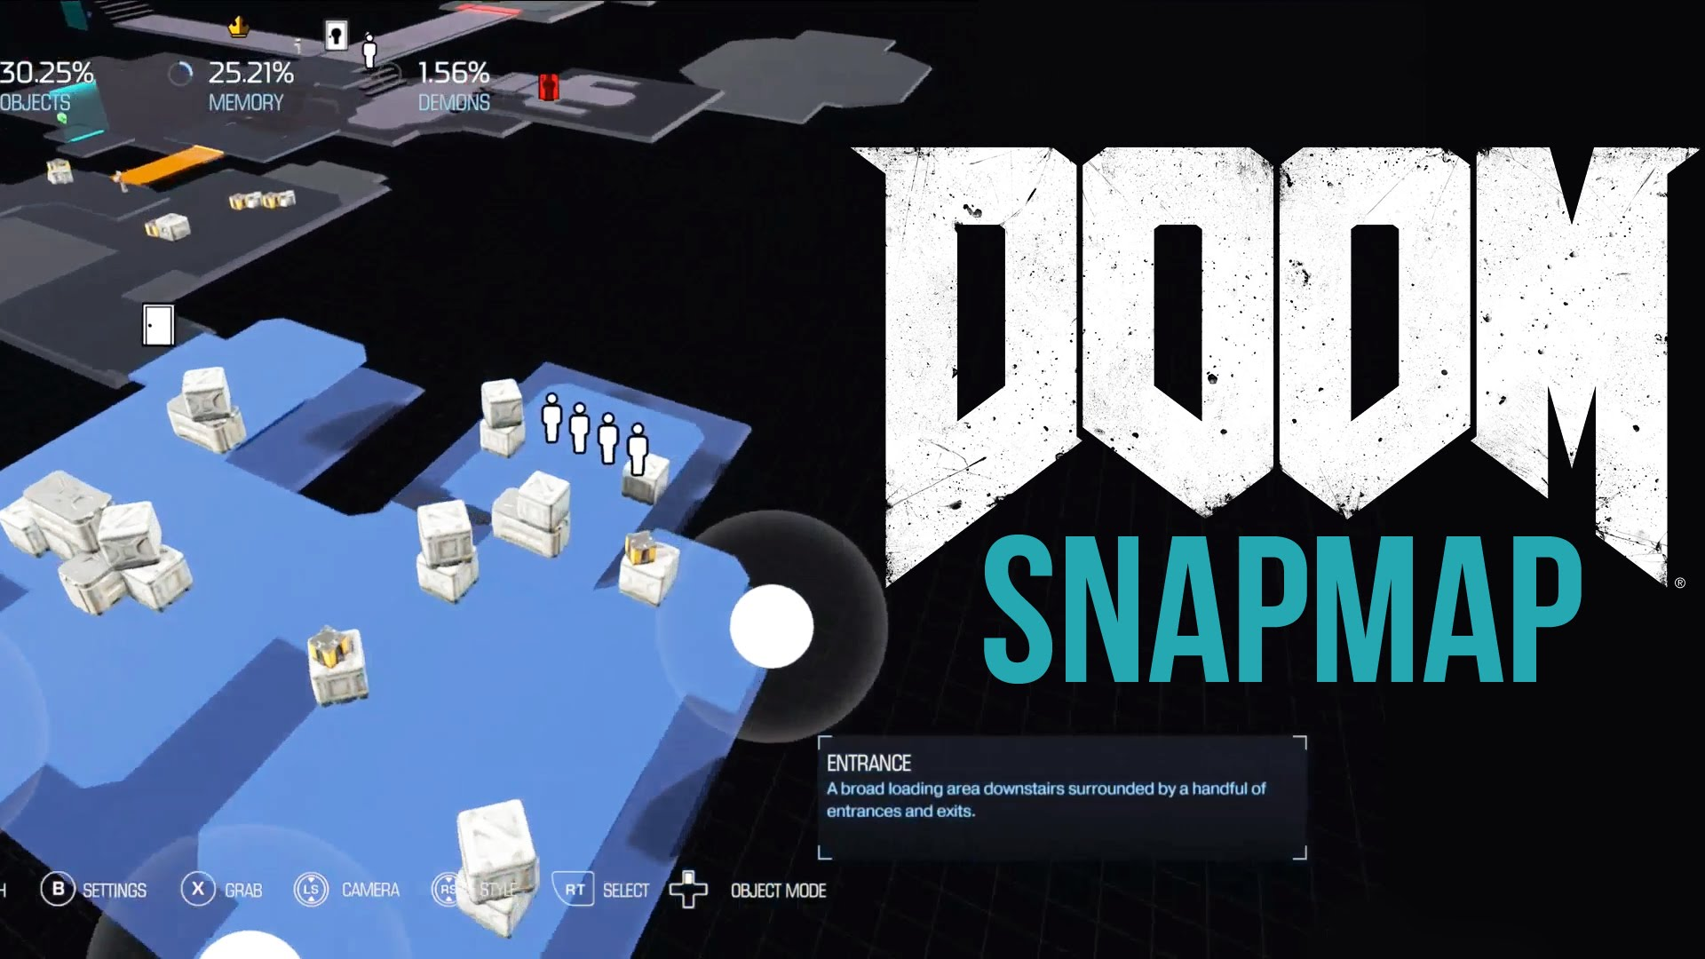
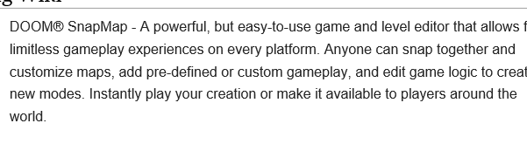

Slide 41
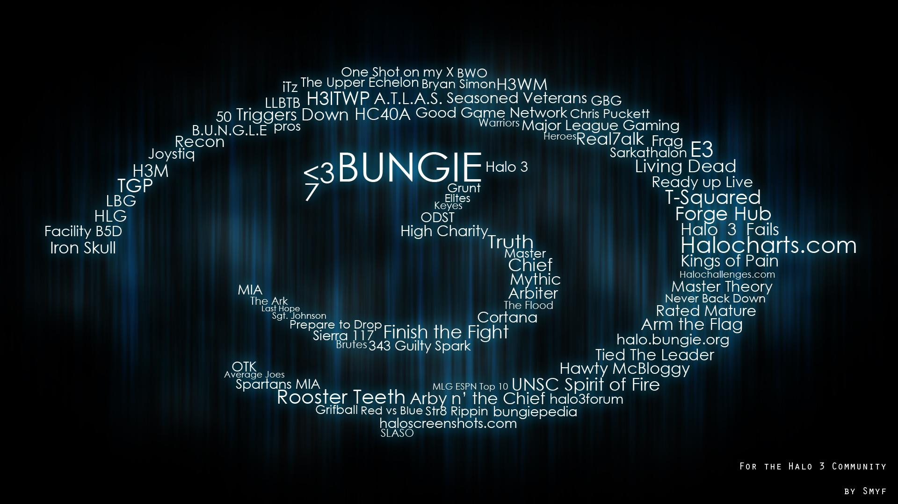
Halo 3 Forge Mode

Slide 42


Slide 43
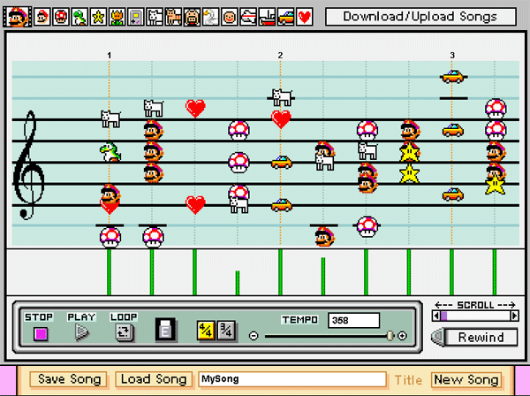




Slide 44
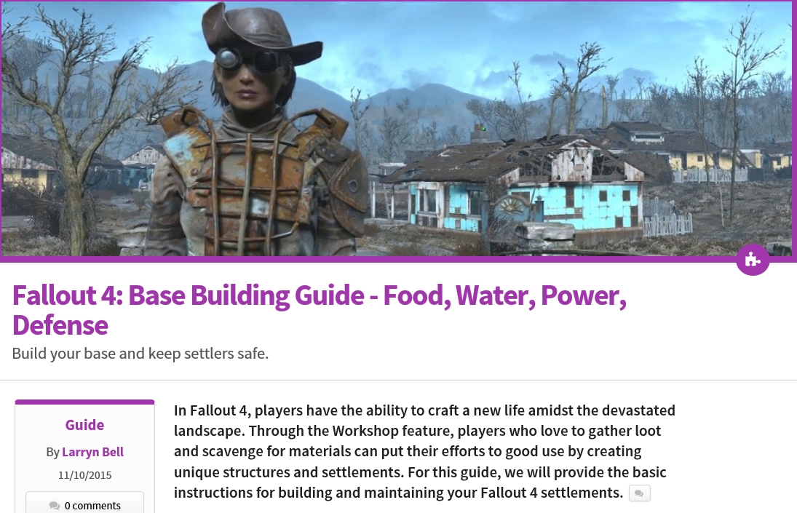
Fallout 4 settlements - The Fallout wiki - Fallout 4 and more - Wikia

Slide 45
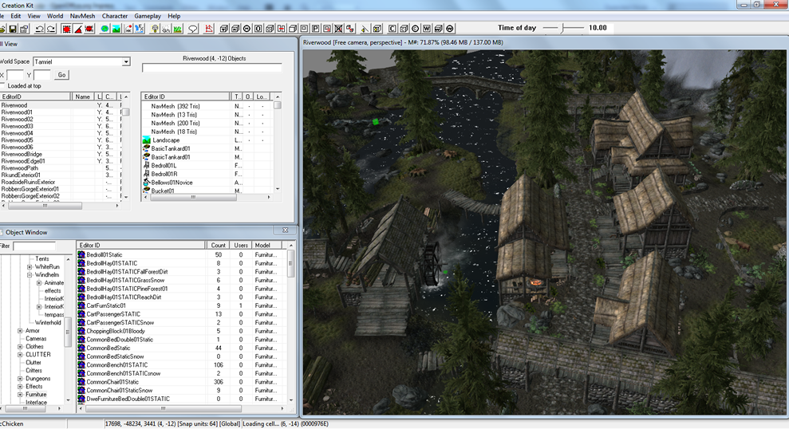
Consider the culture of game Modding

Slide 46
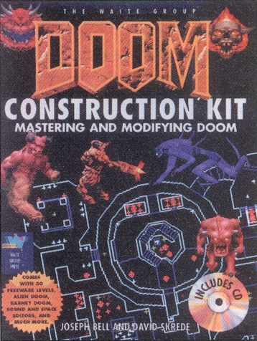
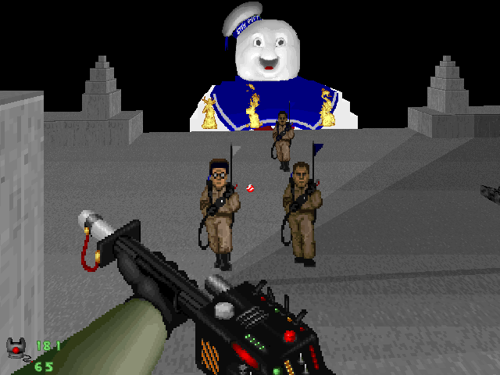


Slide 47

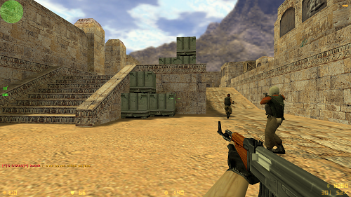
Counter-Strike (1999)
Began as mod of Half-Life
As of Aug 2011, has sold 25 million copies

Slide 48


Slide 49



DAYZ is a MOD of ARMA 2; RUST is a clone of DAYZ and developed by Garry Newman who made GARRY’s MOD. Neat, huh?

Slide 50
The Game As Simulation
Appeals to all of Bartle’s categories.
Player motivation is contact, both with unique experiences, people, and/or events unavailable in real life.
Intrinsic Motivators: numerous—escapism (from both self and environment) and safety.
Extrinsic Motivators: Fame, Fear or Glory
Designer Exploitation: numerous, depending on game—intrinsic motivators can be turned into external ones very easily.
Overlaps well with all game types.

Slide 51



The Game As Simulation: Examples
All games are simulations; players will seek simulations that satisfy their particular needs, desires and curiosities:
Consider Forza, Rock Band or any sports game.
Consider military shooters.
Consider horror games.
Consider MMOs with social goals and constructed identities.

Slide 52


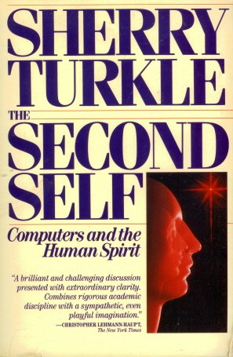
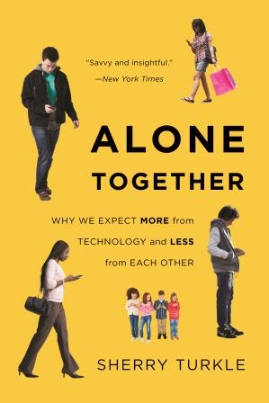
Sherry Turkle: Theorist
We lose ourselves in simulated worlds and can prefer them to the real one.
We can recreate our identities
When game players try to describe video games in terms of other things; the comparison is more likely to be with sports, sex, or meditation. “Television is something you watch. Video games are something you do, something you do to your head, a world that you enter, and, to a certain extent, they are something you ‘become.’”

Slide 53


The Game As Goods
Appeals to Bartle’s ‘achievers’
Player motivation is to consume and collect—a focus on buying or discovering along the journey.
Intrinsic Motivators: goal-setting, curiosity—what can I find? Can I find them all?
Extrinsic Motivators: Fame, Recognition
Designer Exploitation: loot boxes, pay to win, random drops, busy-work collectibles that take advantage of completionists’ OCD.
Overlaps well (and infamously) with ‘game as sport.’
GRINDING

Slide 54

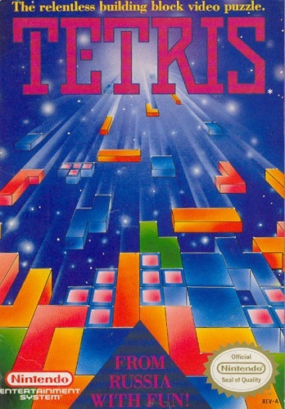

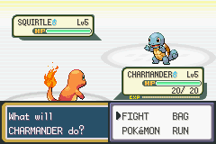
The Game As Goods: Examples
Consider puzzle games built entirely around collecting, matching, or finding, like Candy Crush or even Tetris.
Consider games where victory depends on gear (both purchased and found) and loot drop cycles.
Consider games that provide multiple collectibles or ‘find-alls’ as ‘added’ content.

Slide 55


Consider these “find alls”: Are they worth the trouble?
Zelda: Ocarina of Time: find and kill 100 Skulltulas—tied to a narrative (free a cursed family) and interval rewards (ie: find and kill 30 to get a bigger wallet).
Assassin’s Creed 2: find and collect 100 eagle feathers—unlocks achievement, new item (cape some players found useless), new dialogue with Ezio’s Mom.
Batman: Arkham Asylum: 240 Riddler challenges—unlocks minor XP boosts, but also no less than 8 trophies/ achievements (if one cares). Provides ambience in the game?

Slide 56
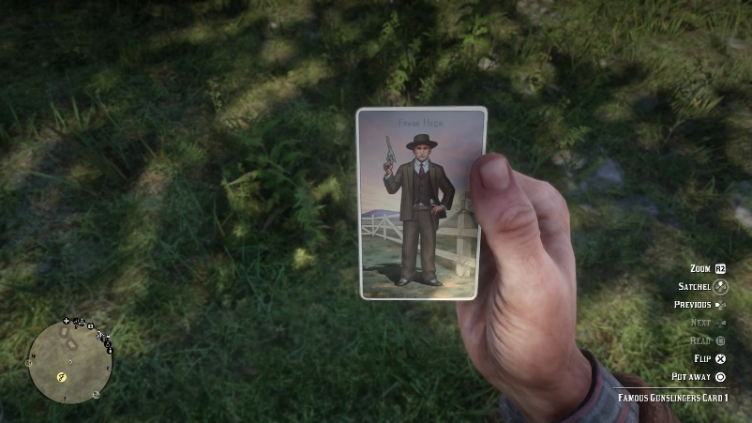
Heck consider Red Dead Redemption 2….
In Red Dead Redemption 2, no less than 4 stranger missions are basically excuses for the “Game as Goods”: big open world collect-a-thons:
Collect dinosaur bones (30)
Collect legendary fish (13)
Collect rock carvings (10)
Collect cigarette cards. (144)
Verdict: a rather cheap and exploitive way to generate game content and player engagement. I say BOO!

Slide 57

Muhlbock’s Taxonomy: Example
Fallout 4:
The Game as Sport: [low] Achievements and goals
The Game as Story: [high] Main story and side quests
The Game as Project: [moderate to high] Building shelters and customizing gear, cooking
The Game as Simulation: [high] Playing in a dystopian world, using weapons and power armour
The Game as Goods: [low] collecting—power armour, bobble heads, paint jobs.
Putting it all together….

Slide 58

Muhlbock’s Taxonomy: Example
Stardew Valley:
The Game as Sport: [moderate] Combat in mines, fishing, self-directed goals
The Game as Story: [moderate] Getting to know the townspeople, giving gifts, romance
The Game as Project: [high] crafting, building shelters, cooking, growing crops, raising animals,
The Game as Simulation: [high] Running your own farm, growing crops, raising animals
Game as Goods: [high] new crops, new animals, ore, new tools, new buildings, new seasons, new recipes
Putting it all together….

Slide 59

More Psychology at “Play” (get it?)
I am Freud, and I approve this slide.
No game design mechanic is “by accident;” they exist to maximize player engagement.
Games are expensive to create and the opportunity for continuous income is too great an opportunity to ignore.
“Forever games”—be they persistent world MMOs or MOBAs—are notorious for implementing questionable design practises to hook players and keep them playing.
However, before we examine the games, we must examine the psychology…

Slide 60

Operant Conditioning
Designed by behaviorist B.F. Skinner in the 50s
Reinforcing behaviour with positive (rewards) and negative (punishment) stimuli
Proven through use of ‘Skinner Box’: lab rats rewarded with food for pressing the correct coloured button when lit/ punished by shocking when pressing the wrong button.
Negative Reinforcement and Punishment are NOT the same thing: NR is the removal of unfavourable circumstances; punishment is action taken (ie: spanking, prison, fines, etc). Punishment is often seen as the weakest way to change behaviour.

Slide 61


Consider Reward Frequency
Variable Ratio Response: Rewards are dispensed but their intervals vary—highly addictive
ie: rare item/weapon drops
Fixed Ratio Response: a continuous stream/or set stream of smaller rewards—conditioning.
Small gold and crafting supplies keep you clicking on boxes/barrels, but the promise of rare items keeps you playing.

Slide 62


Classic Conditioning
I am Pavlov. You are my dog. Say ‘woof!’
A conditioned involuntary reflex through association.
Pavlov’s Dog: dog salivates when it gets food. Buzzer sounds too. Eventually dog salivates at only the sound of the buzzer.
Applied to casinos regarding slot machines: people feel excitement just from the lights and sounds, even when not playing.

Slide 63


The Video Game AS Slot Machine
OPERANT CONDITIONING: the psychology of the Loot Box is undeniable: expectations, or conditioning.
CLASSIC CONDITIONING: Sounds and lights associated with their appearance.
VARIABLE RATIO RESPONSE: Randomized rewards and the hope of the rare item.
Put these all together and give players the option to pay for them and you basically have video games as legalized gambling.
The Skinner Box - How Games Condition People to Play More - Extra Credits - YouTube

Slide 64



Once upon a time WoW dominated the conversation about gaming addiction; however, with pay-to-win and pay-to-loot systems (combined with MOBA competition), the topic has very much gone mainstream. And the bigger issue is whether the loot is merely cosmetic or gives players a competitive edge. Anyway, do some research, and know when you’re being manipulated!

Slide 65

Achievements (XBOX Live) & Trophies (PSN)
Consider the whole insidious nature of “achievement culture” in gaming: they rely on operant conditioning (rewards for behavior) mixed with variable ratio response.
Achievements are meta-goals defined outside of a game's main goal, but do they make a game more fun?
Intrinsic Motivation: feeling of accomplishment
Extrinsic: Recognition? Fame? Gamerscore?

Slide 66

Maslow’s Hierarchy of Needs (1943)
Theory needs is a theory in psychology proposed by Abraham Maslow in his paper “A Theory of Human Motivation.”
Consider how video games uniquely fulfil the last three tiers:
Belonging: Guild or Team
Esteem: Valued for skills or items
Actualization: Creativity or a sense of accomplishment
People who feel fulfilled and valued in their real lives are less likely to seek virtual acclaim.

Slide 67


Negative Reinforcement
A HUGE explanation why some people are drawn to video games to begin with… and then become addicted:
How Video Game Addiction Can Destroy Your Life | VICE | United States

Slide 68




More heartbreaking tales from WoW Addicts
Is Blizzard to Blame? Wow’s most addicting features: goal-oriented play, social pressure to continue, invented identity, and constant updates.
Why is World of Warcraft So Addictive? - YouTube

Slide 69

Zynga
Highly successful and infamous “social gaming” company.
Famous for Farmville, Chefville, Cityville and a bunch of other “villes”
Criticized for making repetitive games that exploit players
Business model seems to be declining, but still made 690 million in 2014.

Slide 70


Criticism of “Social Games” Genre
Ian Bogost has four points of criticism:
Enframing: In social games, friends aren't really friends; they are mere resources
Compulsion: brain hacks that exploit human psychology in order to make money
Optionalism: the gameplay in social games is almost entirely optional. The play acts (...) can be skipped [by] spending cash money [...]. Social games are games you don't have to play.
Destroyed Time: Social games so covet our time that they abuse us while we are away from them, through obligation, worry, and dread over missed opportunities

Slide 71


Candy Crush: An analysis
Genre of “Match 3”:
Easy to learn, hard to master: A grid of tiles in various colors and shapes. Players swap those tiles to make matching strips of three (or more) tiles, which then vanish with a “satisfying” whoosh.
Variable Ratio Response: unplanned moves that eliminate columns—unexpected rewards.
Negative Reinforcement: frustration and release—repeat!
Self-Esteem Boost: You can’t make a move without getting a match and clearing tiles, so every turn delivers a jolt of positive feedback.
Competition: FB friends/members can see your progress

Slide 72


The King of Kong: A Fist Full of Quarters
Interesting film about retro gaming competition.
Key line: It’s not even about Donkey Kong anymore…”
The King of Kong: Fistful of Quarters - YouTube

Slide 73
Conclusion: Be Careful
You can’t “create” intrinsic motivation; you can only create the moments that can inspire it.
Intrinsic Motivation Opportunities:
The ability to create
The power of agency, meaningful choice, and accomplishment via “fair” challenge
The splendor of immersion and exploration via environment and story
Extrinsic Motivation Exploitation
Punishing players for not playing
Public shaming and public praise
Items, loot, trophies, achievements, “collect-all’s”—scarcity and intervals, overused to simulate “progression.”

